Slide 1



Software Engineering Project
- Jan 2023 -

Slide 2



About us
Problem Statement
Type of Users
User Stories
Wireframe
Project Schedules and Design
API Routing
Sample fixture and Test Code
Test Summary
Technology Used
How to Run
Contents

Slide 3


About Us

Slide 4


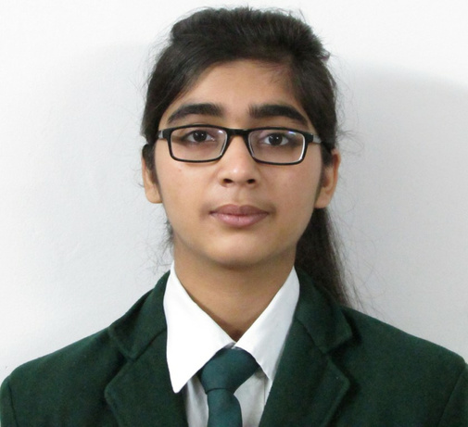


About Us
Vaidehi Agarwal
Tushar Supe
21F1003880
21F1003637

Slide 5


Problem Statement

Slide 6


Problem Statement
The support team at the IITM BSc degree program often get overwhelmed with emails from students regarding queries and concerns.
Your task is to create an online support ticketing system for the IITM BSc degree program. Students can create a support ticket for a particular concern or query.
Before they create a ticket, the system should also show a list of similar tickets, and allow users to like or +1 an already existing support ticket, so that duplicates are not created.
After the support team addresses the concern, they can mark the ticket as resolved, and an appropriate notification should be sent to concerned users.
Another important feature of the ticketing system is dynamic FAQ updation.
Many student concerns can be FAQs which will be useful for future students. If appropriate, the support query and response should be added to the FAQ section by support admins, and appropriately categorized, so that an updated FAQ will be readily available to students.
The platform should allow users to enroll as students, support staff and admins.

Slide 7



Type of Users

Slide 8
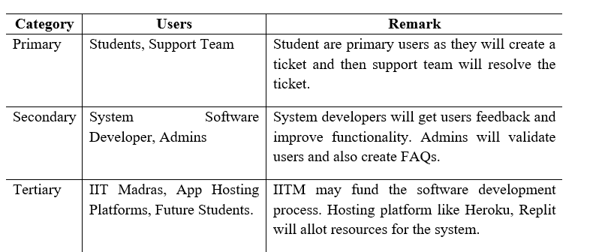


Slide 9
User Stories

Slide 10
User Stories
USER
SUPPORT STAFF
As a student,
I want to register,
So that I can start using support ticket system
As a support staff,
I want to see highest priority unsolved concerns first,
So that they can be answered first.
ADMIN
SOFTWARE DEVELOPER
As a system admin,
I want to see list of most voted concerns,
So that I can convert them into FAQ for future students.
As a system software developer,
I want to get feedback from users,
So that I can improve the functionality as well as add extra features.

Slide 11
Wireframe

Slide 12
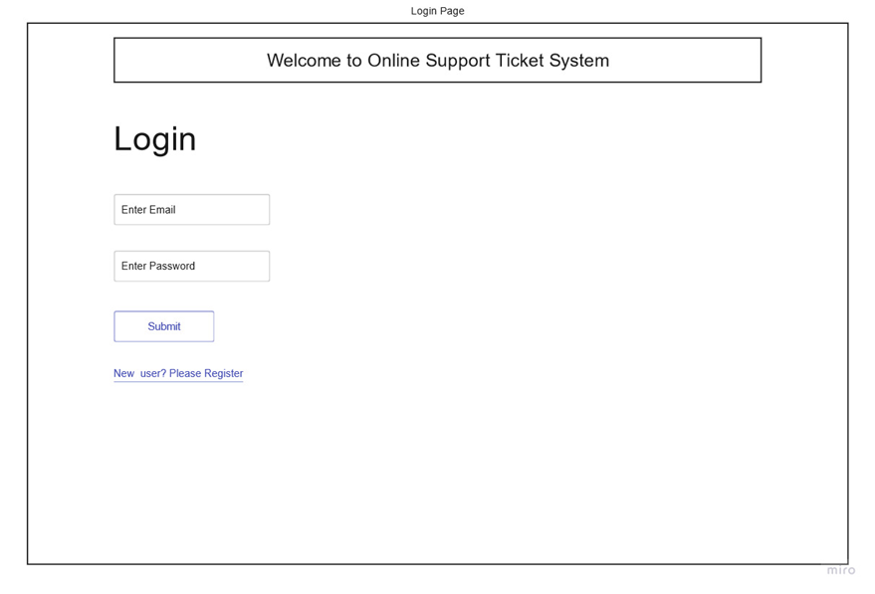
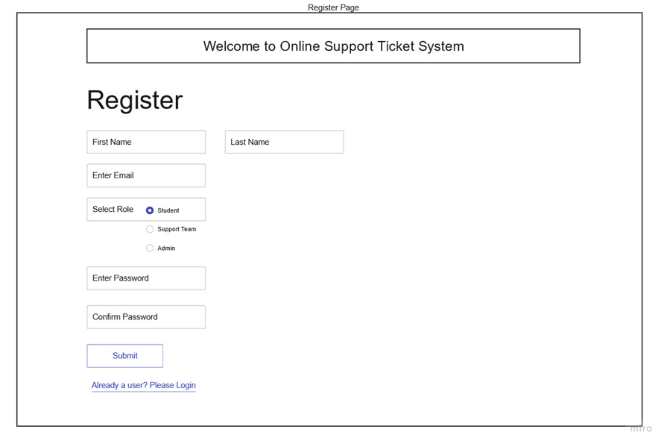
LOW FIDELITY WIREFRAME
COMMON
Login
Register

Slide 13
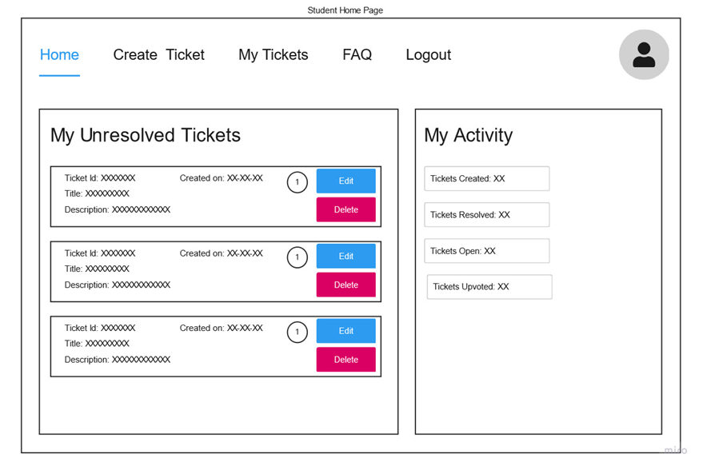
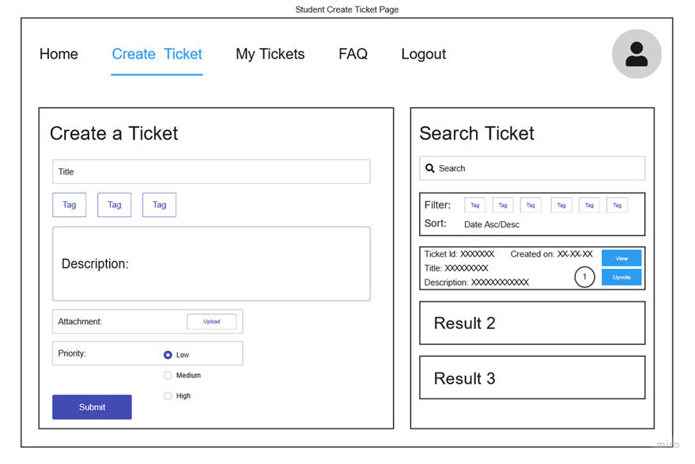
LOW FIDELITY WIREFRAME
USER: STUDENT
Home Page
Create Ticket Page

Slide 14
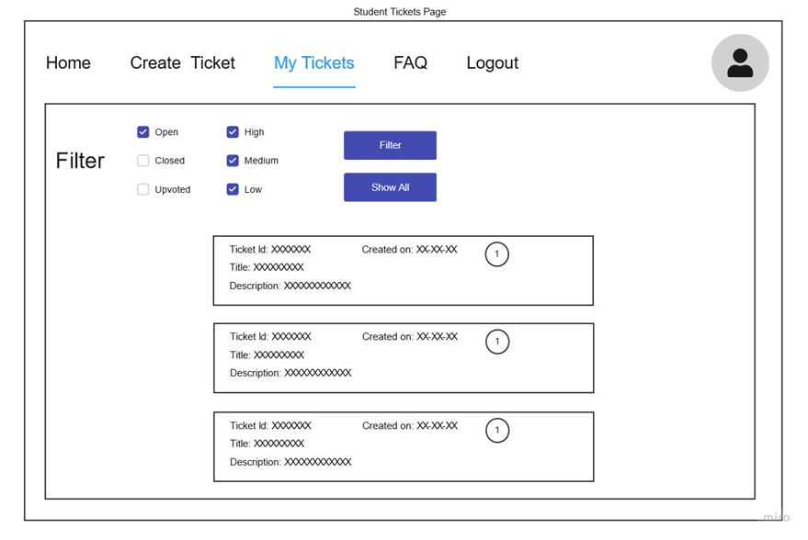
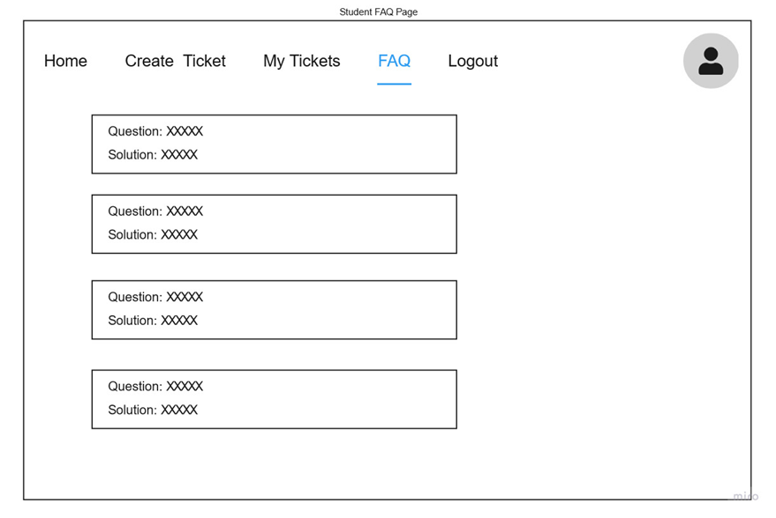
LOW FIDELITY WIREFRAME
USER: STUDENT
My Ticket Page
FAQ Page

Slide 15
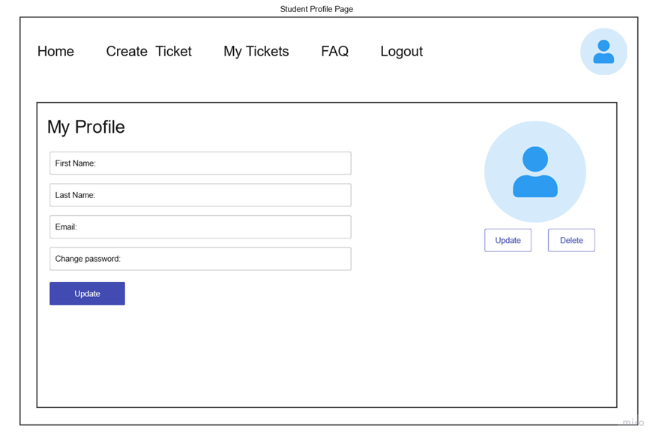
LOW FIDELITY WIREFRAME
USER: STUDENT
Profile Page

Slide 16
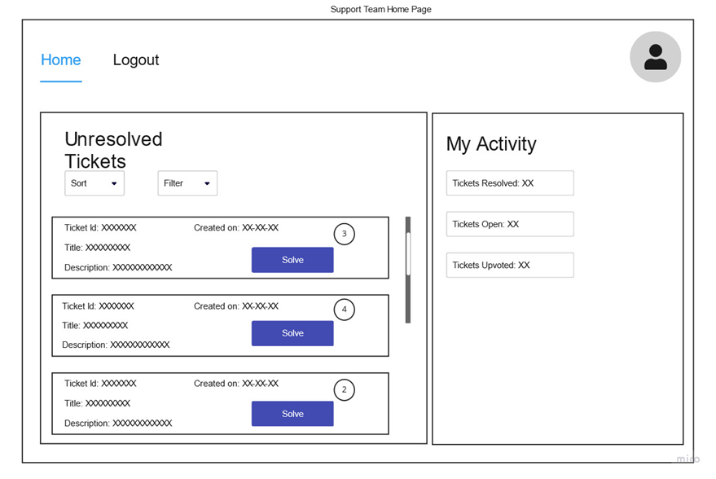
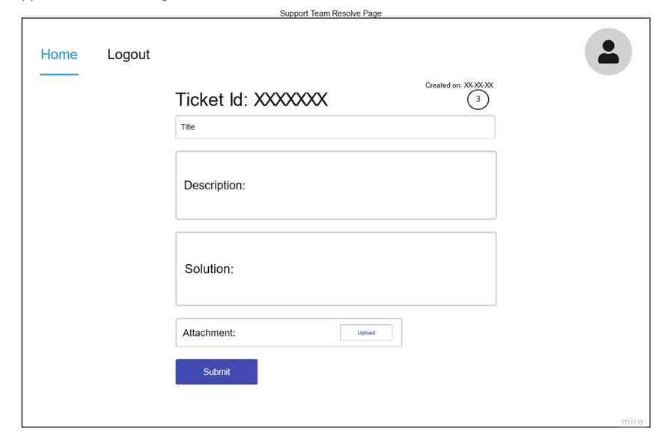
LOW FIDELITY WIREFRAME
USER: SUPPORT STAFF
Home Page
Ticket Resolev Page

Slide 17
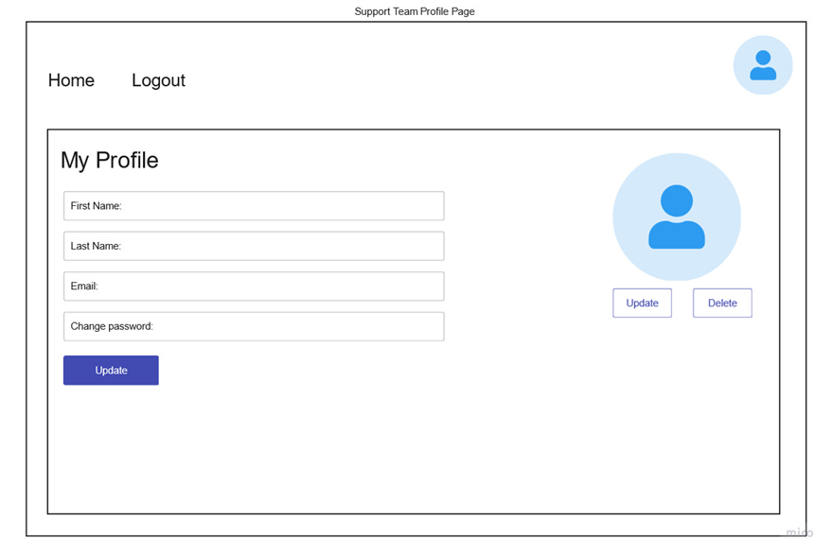
LOW FIDELITY WIREFRAME
USER: SUPPORT STAFF
Profile Page

Slide 18
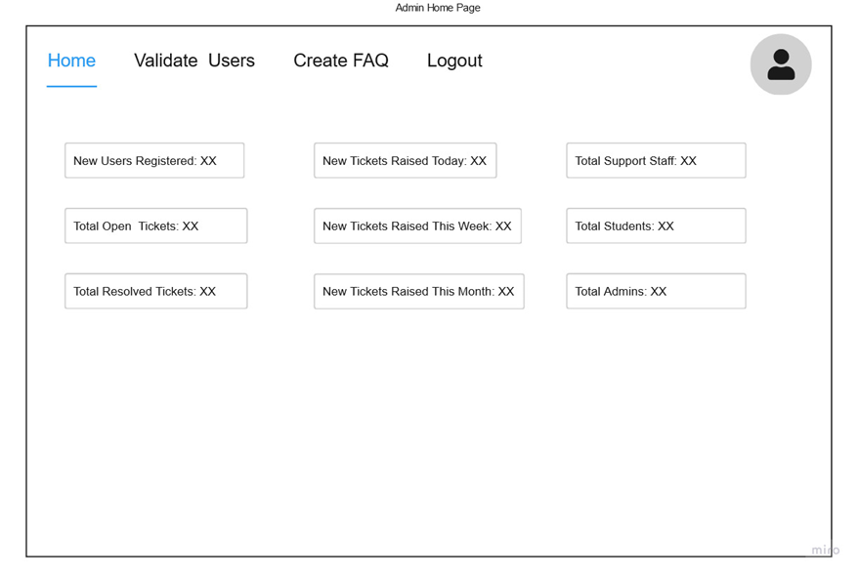
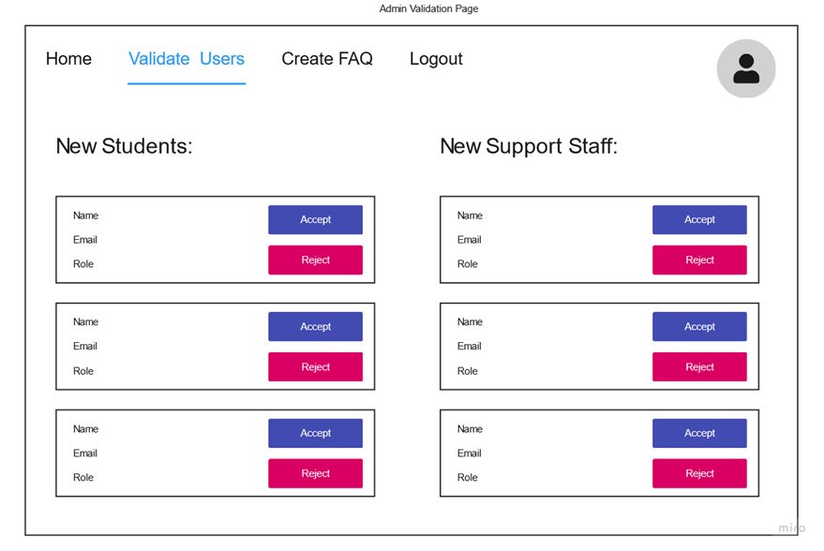
LOW FIDELITY WIREFRAME
USER: ADMIN
Home Page
Validation Page

Slide 19
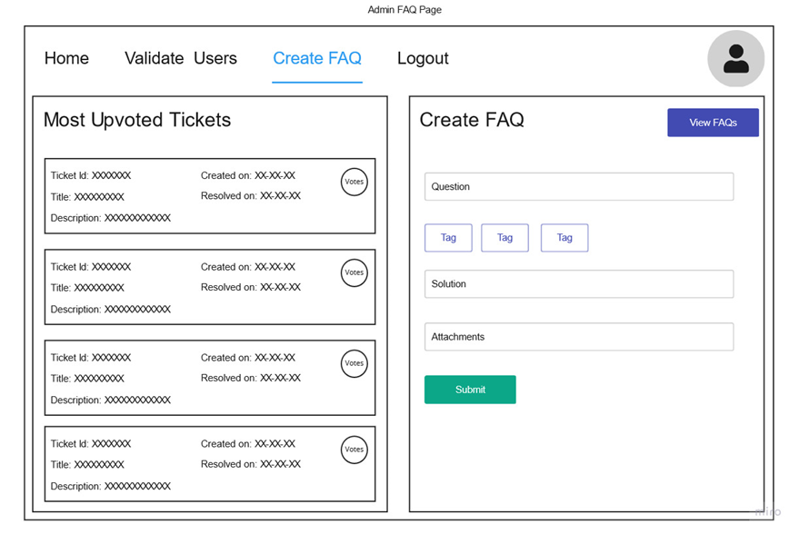
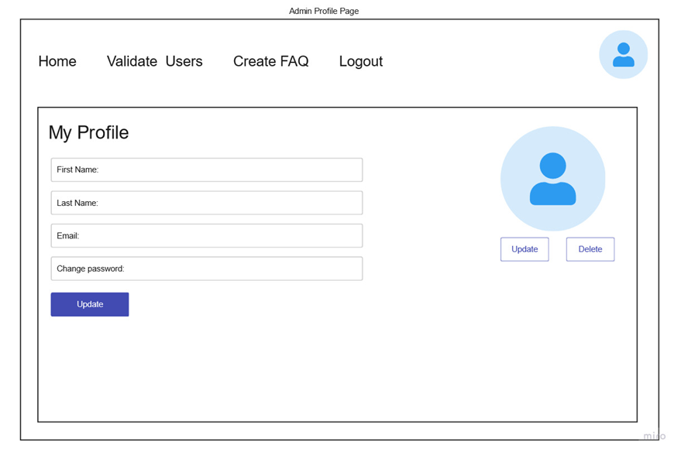
LOW FIDELITY WIREFRAME
USER: ADMIN
FAQ Page
Profile Page

Slide 20
Project Schedules and Design

Slide 21
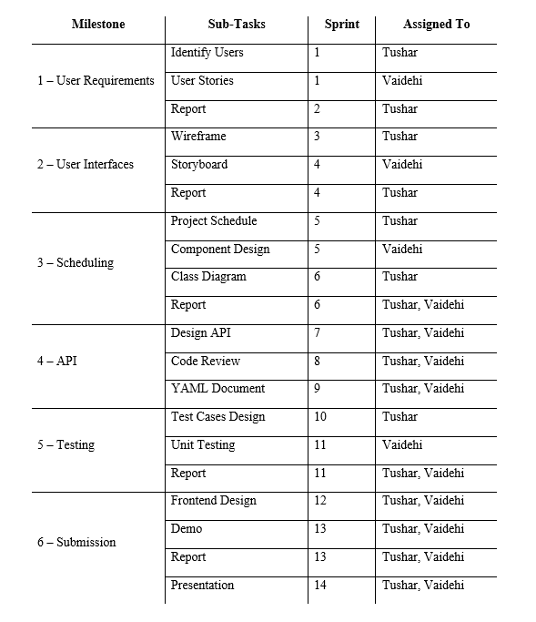
Project Schedule

Slide 22
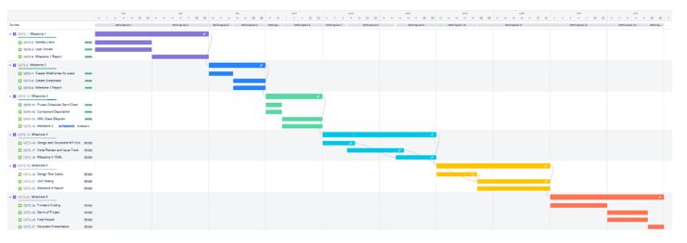
Gantt Chart of schedule

Slide 23
API Routes

Slide 24
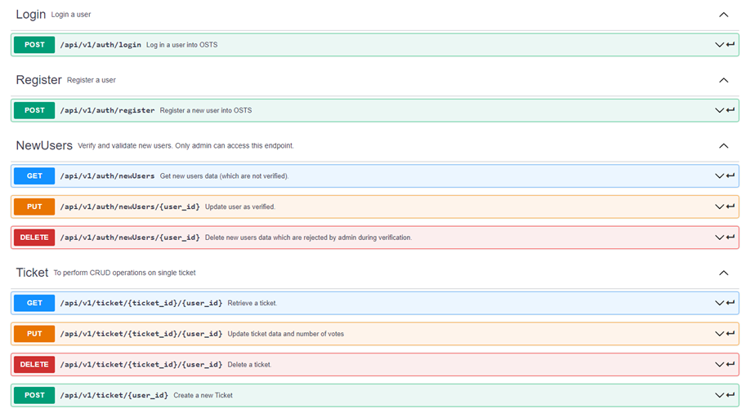

Slide 25
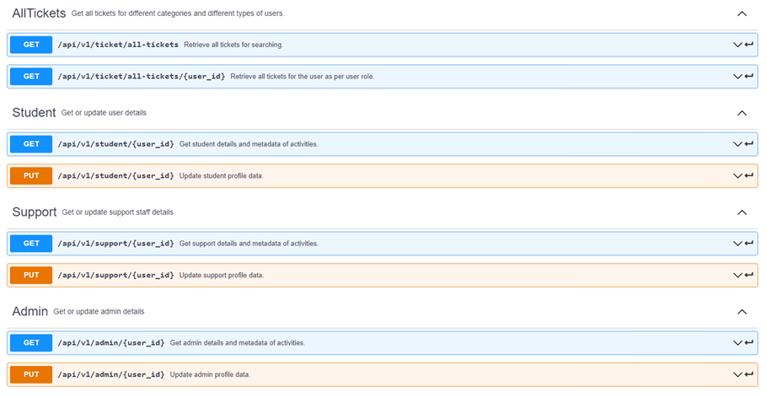

Slide 26
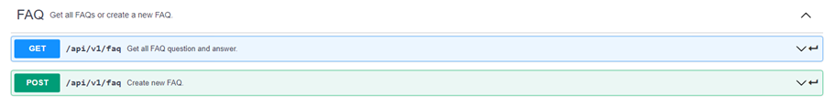

Slide 27
Sample fixture and Test Code

Slide 28
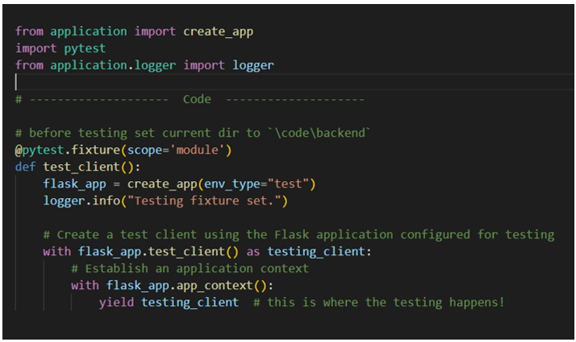
Create App Fixture

Slide 29
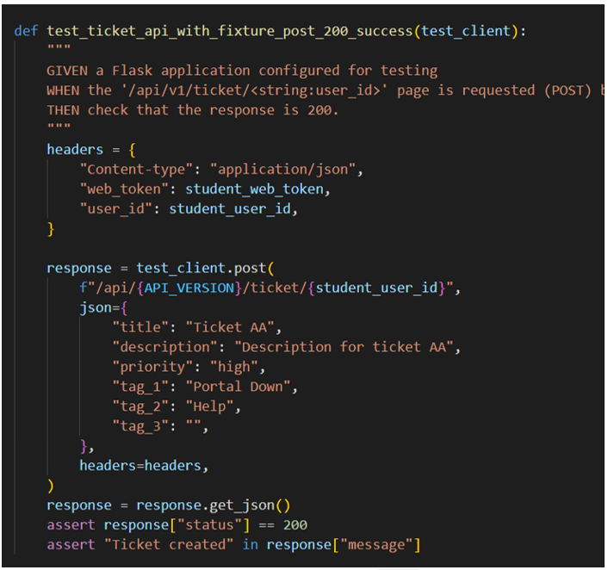
Sample Test Code

Slide 30
Test Summary

Slide 31
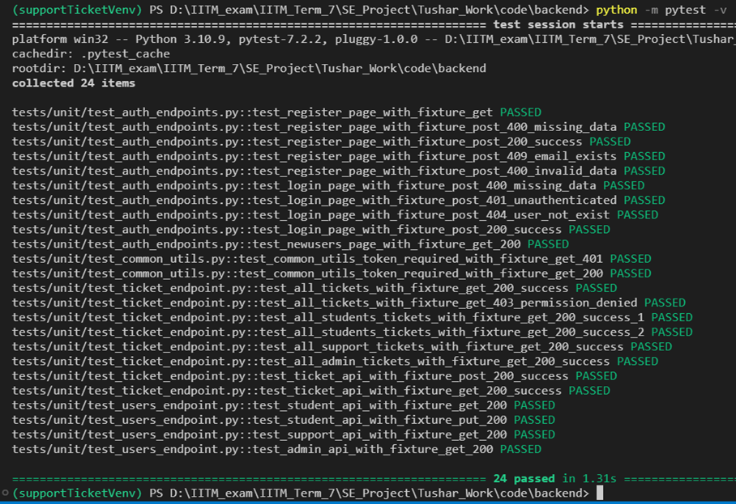

Slide 32
Technology Used

Slide 33
General
Programming Language: Python and JavaScript.
Wireframes built in ‘Miro’.
API doc built in ‘Swagger’.
API testing is done with ‘Insomnia’.
App testing is done with ‘PyTest’.
Coding IDE is ‘Visual Studio Code’.
Version Control is done with ‘Git’ and ‘GitHub’.

Slide 34
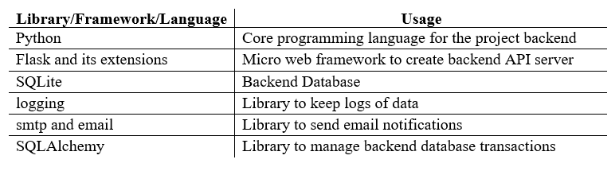
Backend Technologies

Slide 35
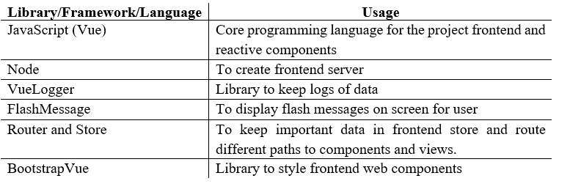
Frontend Technologies

Slide 36
How to run

Slide 37
The project sends notification mails whenever required and for security purposes, ‘MailHog’ application is used in the backend.
So, this application is currently hosted locally only.
The ‘backend.bat’ file, ‘frontend.bat’ file and ‘MailHog_windows_amd64.exe’ file are present in the ‘code’ directory.
Instructions

Slide 38
Steps to follow
STEP 1
STEP 2
Start the ‘MailHog_windows_amd64.exe’ so that the emails sent during the usage of app, will be captured by ‘MailHog’ at http://127.0.0.1:8025/.
Then run the ‘backend.bat’ file. It starts the backend server which handles database manipulations and API functions. It runs at http://127.0.0.1:5000/
STEP 3
Then run the ‘frontend.bat’ file. It starts the frontend server which serves web pages for the frontend user.

Slide 39
FINALLY, VISIT ‘HTTP://127.0.0.1:8080/HOME’ PAGE ON BROWSER.

Slide 40

Thank
you

